Slide 1
PROJECT REPORT EMPLOYEE ATTRITION CONTROL
Problem Statement
The data is for company X which is trying to control attrition. There are two sets of data: "Existing employees" and "Employees who have left". Following attributes are available for every employee.
Satisfaction Level
Last evaluation
Number of projects
Average monthly hours
Time spent at the company
Whether they have had a work accident
Whether they have had a promotion in the last 5 years
Departments (column sales)
Salary
Whether the employee has left
OBJECTIVES
Explain the reasons employees are prone to leave after analyzing this data set.
Explain what type of employee are prone to leave the company.
Predict the future employee who would tend to leave the company

Slide 2
Types of analytics used
Descriptive statistics – Used to summarize data. Different measurements are used to have a good understanding of the dataset.
Exploratory Analysis – Use visualizations to identify patterns and relationship between variable
Predictive analysis – Create a classification model that will help in predicting the next employees to leave.
Prescriptive analysis – Give a solution to the problem

Slide 3
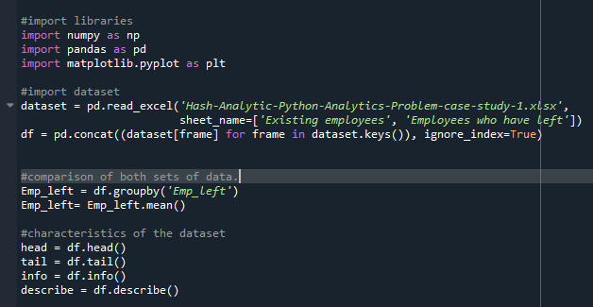
Descriptive Analysis
Determine dataset characteristics that will help in identifying patterns in the dataset.
Steps involved
Importing libraries
Importing dataset
Check dataset’s attributes name and data types using the info() function.
The dataset is divided into 2 groups, therefore need for comparison of their characteristics.
The groupby() and mean() function are used to find the average of the two datasets.
The describe() function gives a summery statistics of the dataset.

Slide 4
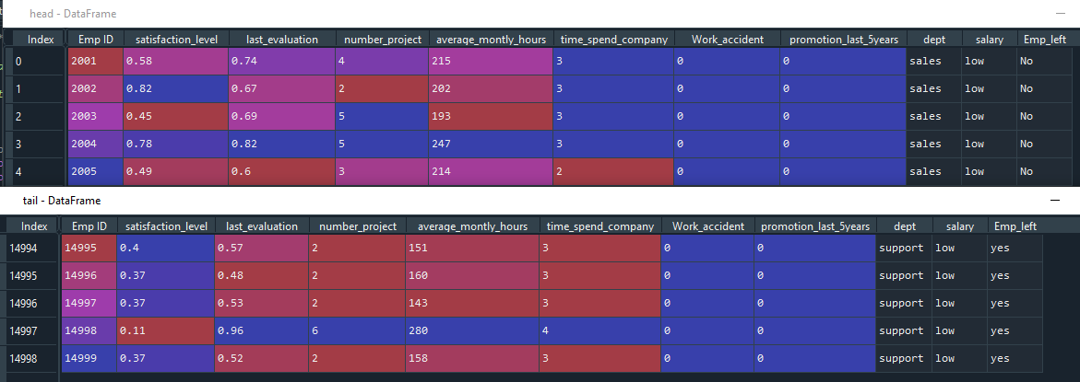
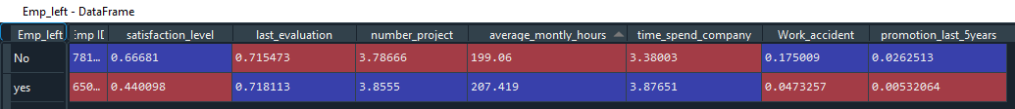
Average, head, and tail of the data

Slide 5
Exploratory Analysis
Using visualizations, we determine relationships between variables using a common factor. The average statistics shows that employees who left had characteristics such as :
low satisfaction level
high number of projects
high average monthly and
low promotional rate
The key factor that influences employee attrition is satisfaction level. Employees who are less satisfied with their jobs are more likely to leave.
The following visualizations shows how different factors affect an employee’s job satisfaction level.

Slide 6
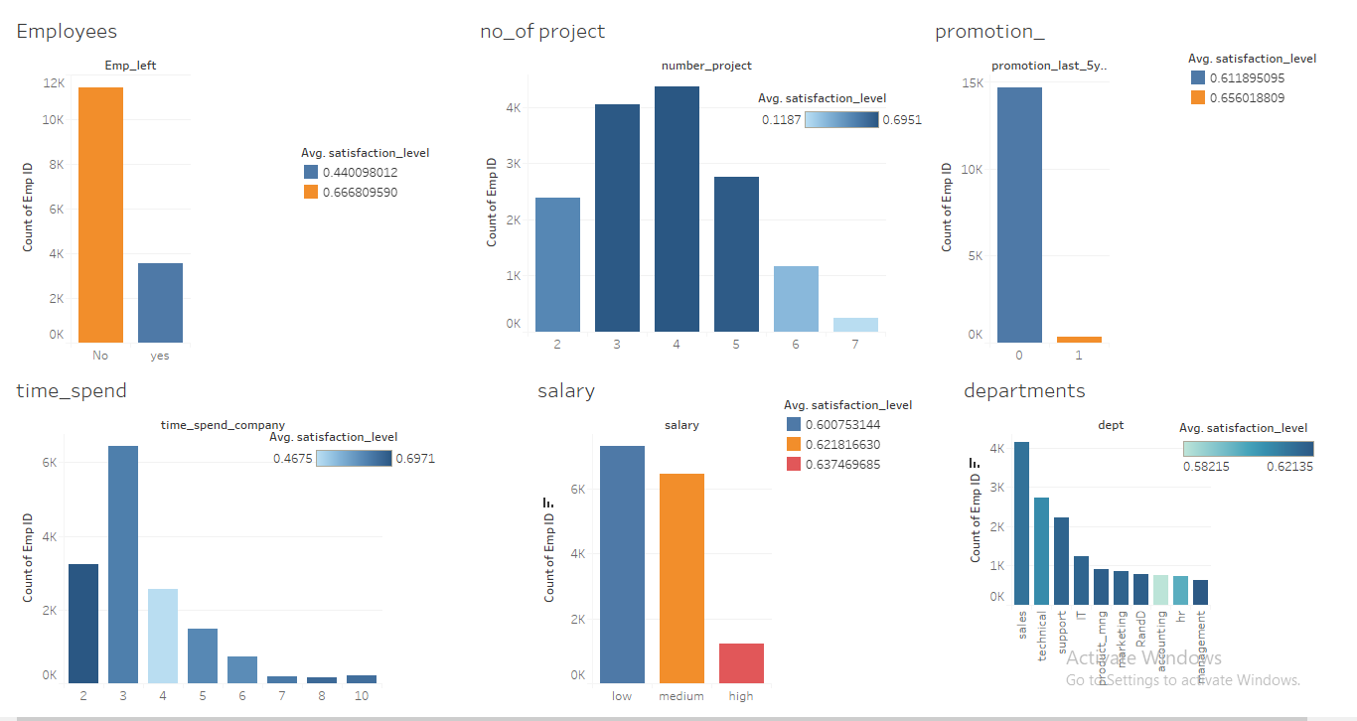

Slide 7
Observations from the visualizations.
Observations from visualizations showing the characteristics of the employees who left the company
Employee attrition in the company was caused by :
Employees having 2 projects or more than 5 projects.
Many employees left in their third year at the company.
Employees with low and medium salaries.
Employees without a promotion in the last 5 years.
More than 5 projects cause low satisfaction level.
The few employees who have been promoted the last 5 years have a high satisfaction level.
There is a huge gap between employees who have spent 3 years and 4 years at the company. Most employees with 4 years of experience in the company have low satisfaction level
Employees with a high salary have high satisfaction level
Employees in the accounting and hr. departments are least satisfied.
Conclusion: The number of projects and the time the employees spend at the company have the greatest impact on employee satisfaction level.

Slide 8
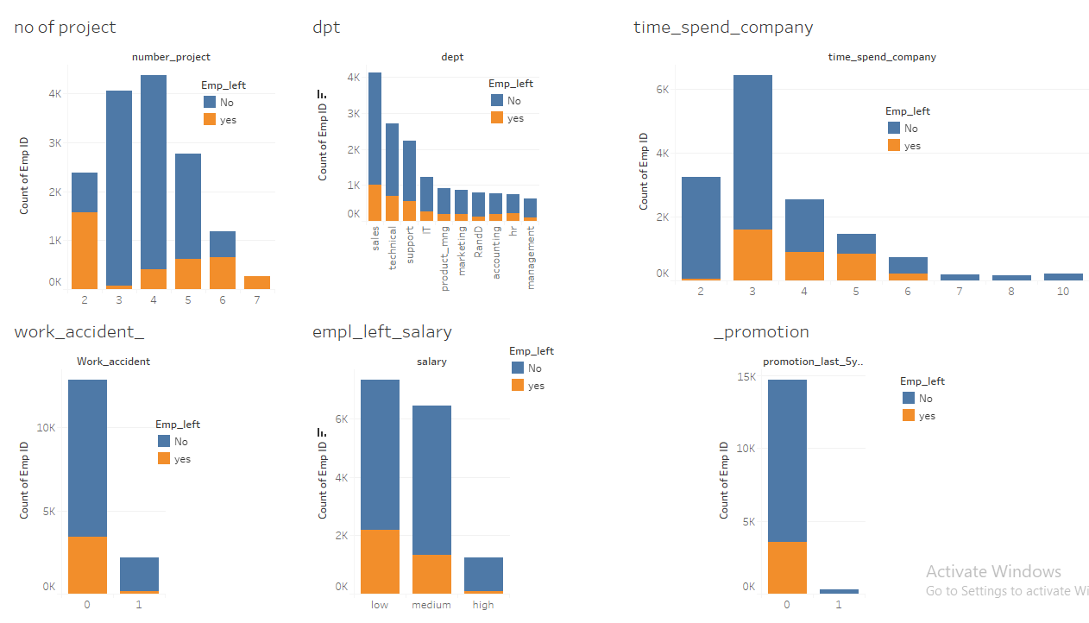
The following visualizations shows the characteristics of the employees who left the company, that is, the factors that contributed to employee attrition at the company

Slide 9
Conclusion
Reasons employees are prone to leave the company
Employees with less than 3 projects and more than 5 projects.
Employees with low and medium salaries.
Time with Company: The three-year is a crucial point in an employee's career. Most of them leave at around the three-year mark. Another important point is 6-years point, where the employee is very unlikely to leave.
Employees who have spent 5 or six years in the company without a promotion in the last 5 years.
Types of employees prone to leave the company.
Employees with high evaluation but low satisfaction level. These are employees who are likely to have more than 5 projects or less than 3 projects.
Moderate employees who have medium evaluation and satisfaction level. These are employees who are probably in their third year at the company.
Employees who have high evaluation and high satisfaction level. Factors that are likely to cause the departure of these kind of employees are such as lack of promotion in the last 5 years.

Slide 10
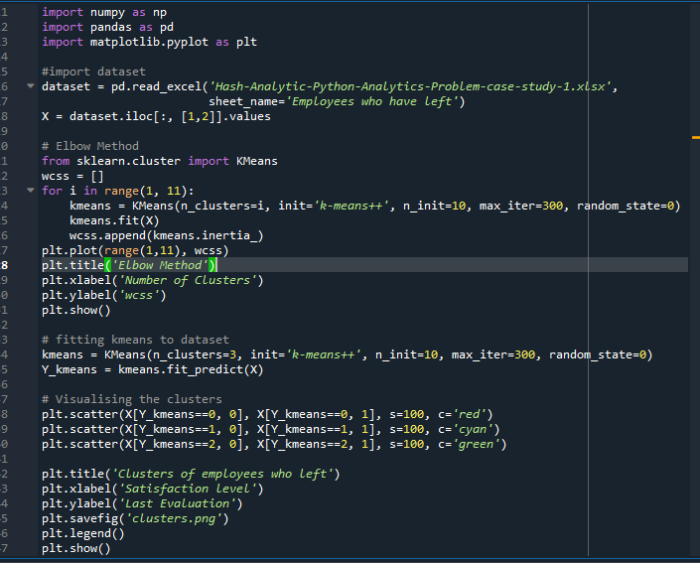
Cluster analysis
Cluster analysis is used to determine the group type of employees who left the company.
K-means clustering is an unsupervised machine learning algorithm used for cluster analysis.
Working of the k-Means algorithm.
Choose the number of clusters
Assign the centroid of each cluster
Assign each data point to closest centroid that will form k clusters
Computer and again, a new centroid is placed to each cluster.
Reassign each data point to new closest centroid.
Process of k-Means algorithm.
Import libraries
Import dataset
Determine number of clusters using the Elbow method
Train the machine learning model.
Visualize the clusters.

Slide 11
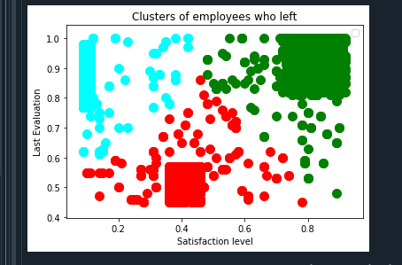
Types of employees who left
Blue – Represent employees with high evaluation and low satisfaction level. These are aggravated employees
Red – Represents moderate employees. Employees with moderate evaluation and satisfaction level.
Green – Represents employees with high evaluation and high satisfaction level. These employees are a great asset to a company. Their departure is a loss to the company.

Slide 12
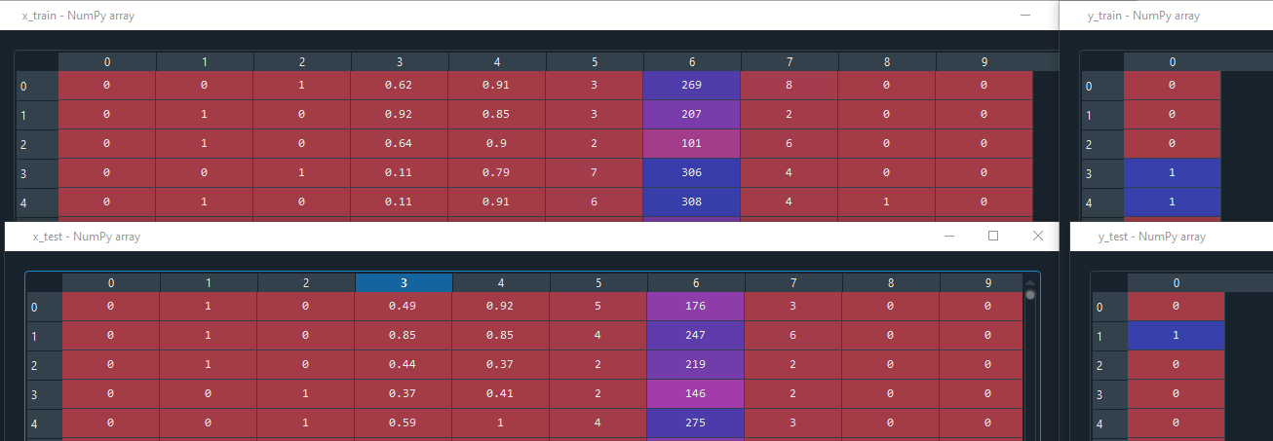
Predictive Analysis
Predictive analysis is used to predict which employee is prone to leave next.
Predictive analysis is achieve by building a prediction model using the random forest classifier. This is because compared to other algorithms, random forest has the highest accuracy rate
Steps involved in building a prediction model:
Data preprocessing
Import libraries
Import dataset
Encode categorical data to numerical data
Split data into train and test set in order to understand the model performance.
Training the dataset by fitting random forest classifier to training set.
Predicting the test results.
Using confusion matrix to evaluate the model performance.

Slide 13
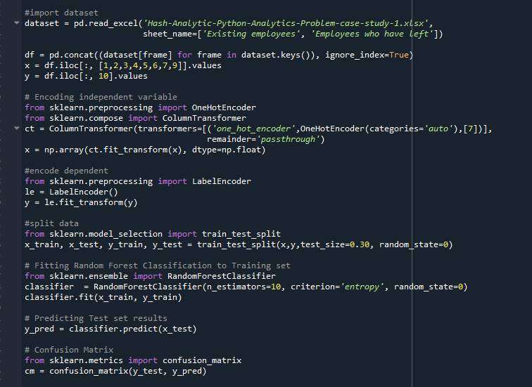

Slide 14
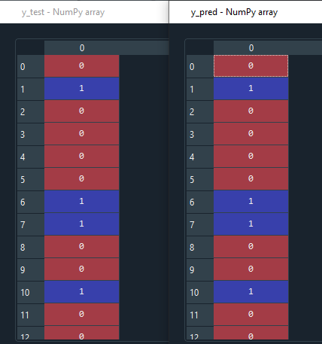

Prediction output
The random Forest Algorithm has an accuracy rate of 99%. The confusion matrix is used to measure accuracy of an algorithm.
AR= ((3422+1036)/4500)*100 = 99%
With the model we can now predict the employees who are prone to leave next.
# Confusion Matrix from sklearn.metrics import confusion_matrix cm = confusion_matrix(y_test, y_pred)

Slide 15
Solution To the problem statement
Analyze the characteristics of the employees prone to leave and apply relevant actions in order to retain them. These actions are such as:
Improving the factors that contribute to job satisfaction.
Improve their working conditions. That is,
Increase the number of projects for employees with 2 projects and reduce the number of projects for employees with more than 5 projects.
Reduce average monthly hours for overworked employees
Promote employees with 5 or more years spent at the company.
The company can also use a model that gives recommendations to improve job satisfaction for employees prone to leave.

